Slide 1


GROUP D Project Presentation On
REAL ESTATE MANAGEMENT
This Photo by Unknown author is licensed under CC BY-SA-NC.

Slide 2
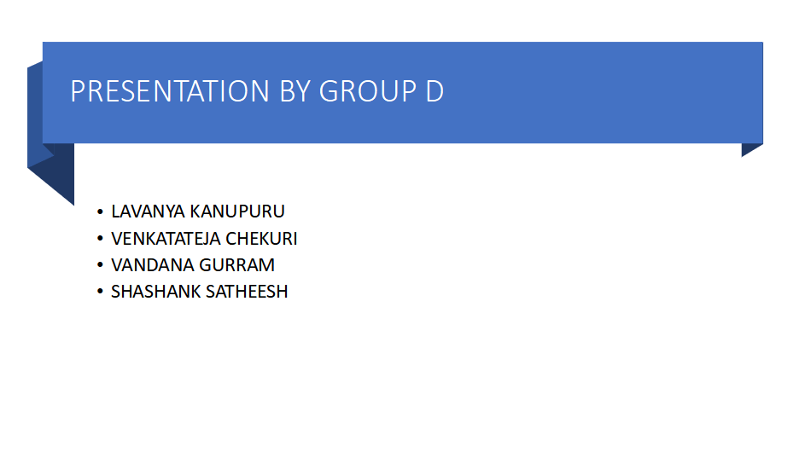

Slide 3
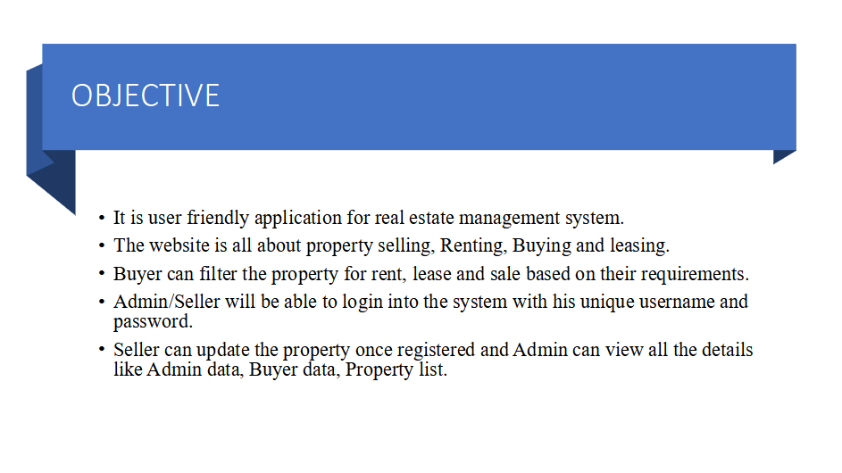

Slide 4


Slide 5
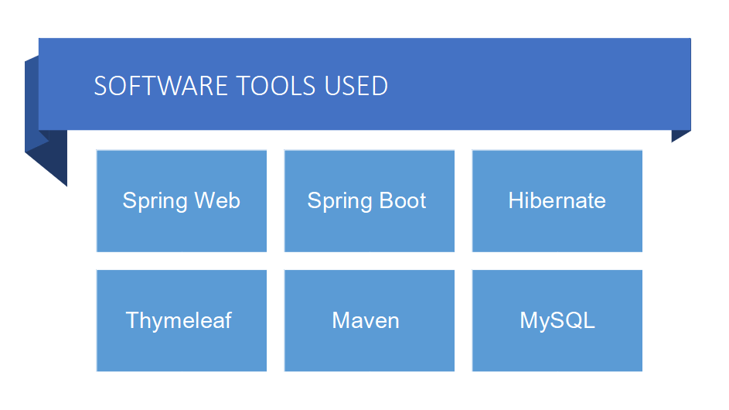

Slide 6
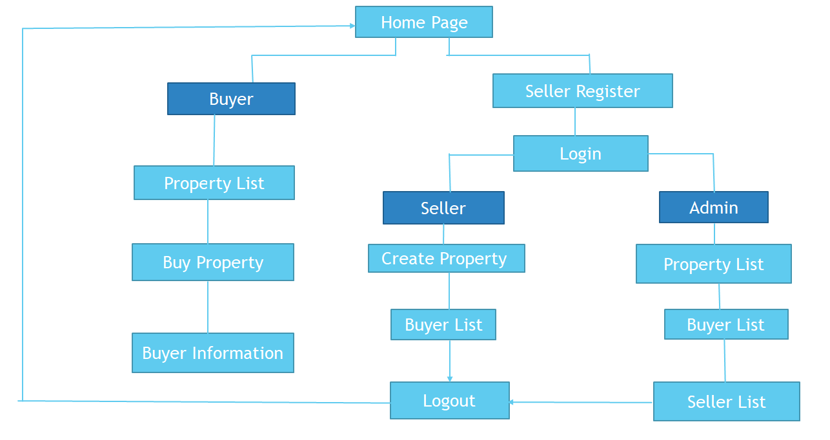
FLOW CHART

Slide 7
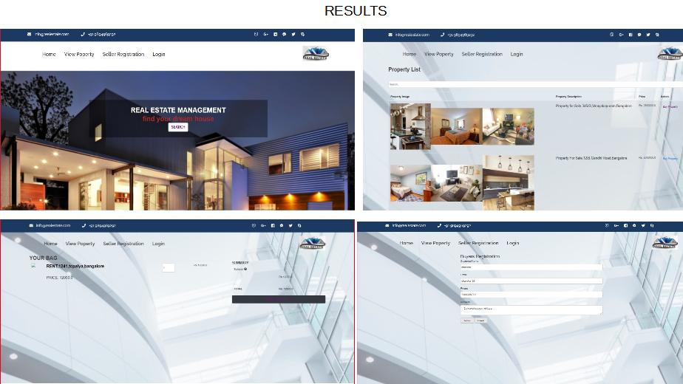

Slide 8
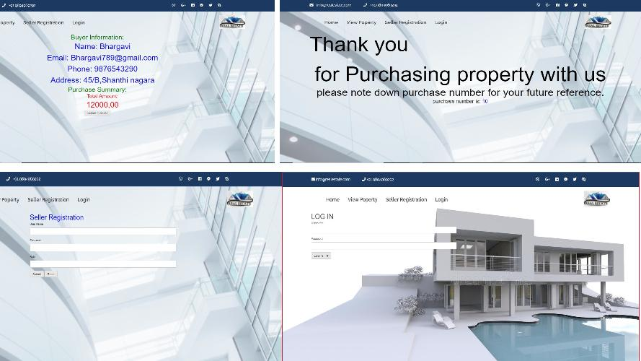

Slide 9
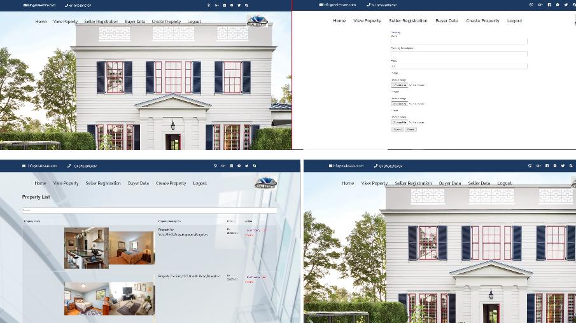

Slide 10
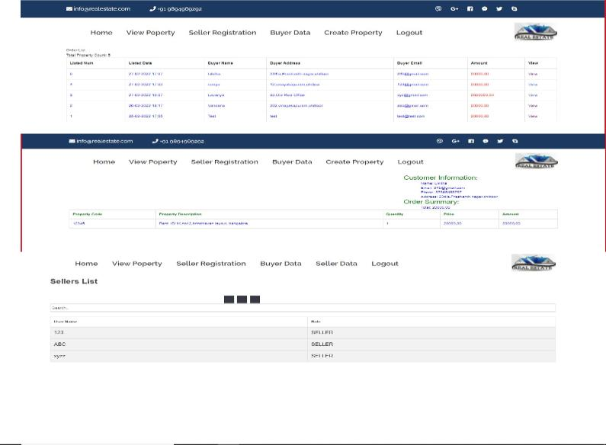

Slide 11
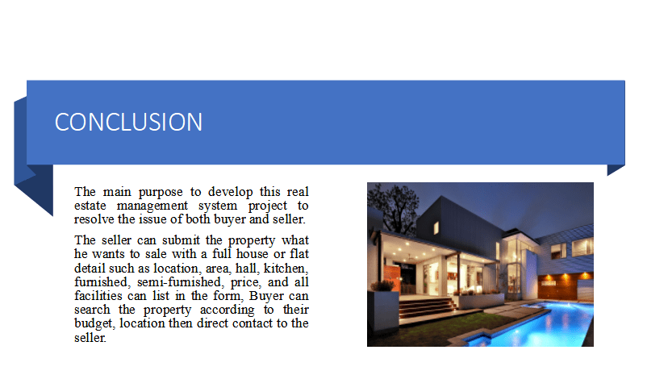

Slide 12


